Slide 1



Intelligent Applications in NLP: Advanced Chatbot & Fine-tuning of Large Language Models
Supervisor: Dr.Sara Abd-Elmoaty
Team Members:
Abdallah Samir
Youssef Samy
Shaaban Mosaad
Mostafa Elesely
Mohamed Badrawy
Nada Eldarderi

Slide 2
Agenda
Introduction
Objectives
Main points
Conclusion

Slide 3
Intro
This project aims to fine-tune the Qwen Large Language Model (LLM) for advanced news-related NLP tasks in Arabic and English, such as summarization, translation, keyword extraction, and entity recognition.
We use tools like:
Hugging Face Transformers
LoRA for efficient fine-tuning
Quantization to reduce memory
Pydantic for data validation
wandb for tracking
Google Colab GPUs for training
The goal is to create a lightweight, specialized version of Qwen for accurate and efficient news processing.

Slide 4
Objectives of Chatbot
Project Idea: Build a chatbot capable of understanding user queries in colloquial or formal language and providing appropriate responses based on a predefined set of patterns and responses.
Objectives:
Develop a simple automated chat system using Long Short-Term Memory (LSTM) networks.
Train the model on a custom dataset to handle specific types of questions and provide relevant answers.
Create a simple user interface (using Streamlit) to interact with the chatbot.

Slide 5
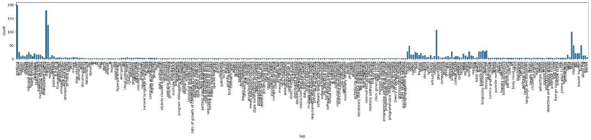
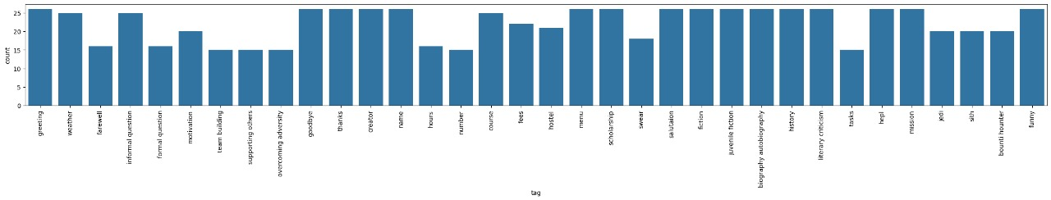
Dataset Distribution Analysis
Observation: The dataset is highly unbalanced, with some tags (like “hello”, “greeting”) dominating the distribution.
Impact: Training the model on this raw data would bias it towards frequent tags, reducing accuracy on rare ones.
Action Taken: We cleaned and balanced the dataset to ensure fair model performance.

Slide 6

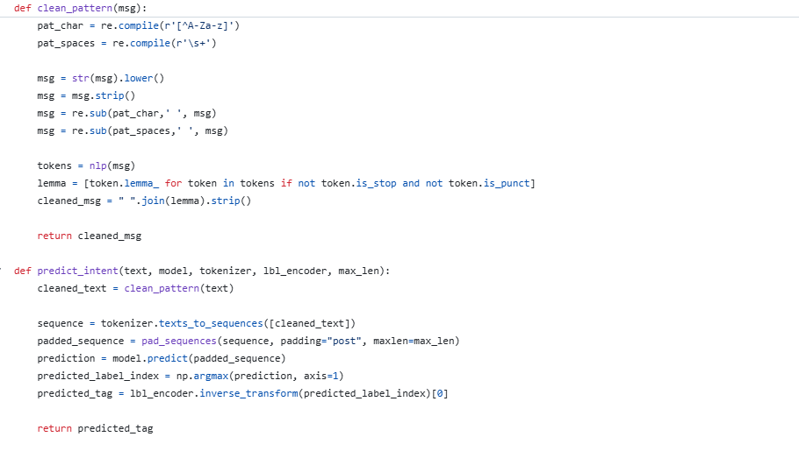
Code Snippet

Slide 7
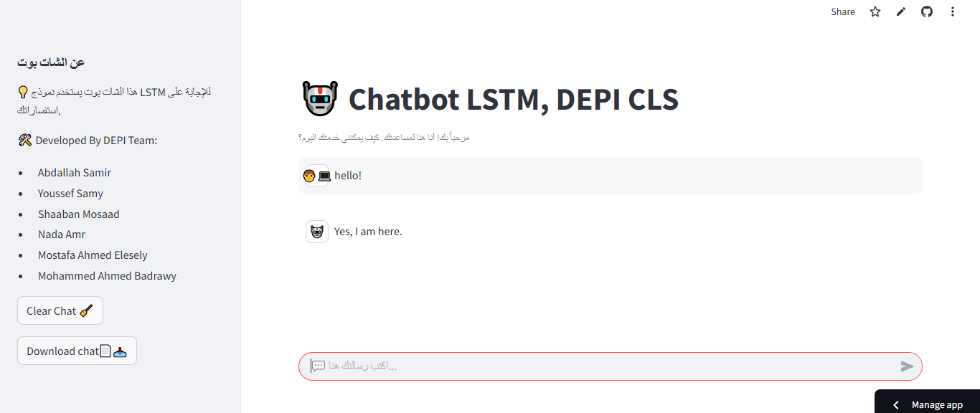
Chatbot Deployment
🌐 Deployment Overview:
The chatbot was successfully deployed using Streamlit Community Cloud.
This makes the model easily accessible online for real-time interaction.

Slide 8
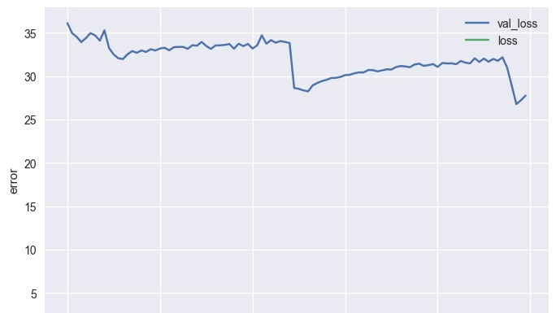
From LSTM to Transformers — Why the Shift?
Problem with LSTM:
While training on our dataset, the LSTM model quickly overfitted.
It learned the training data well, but failed to generalize to new examples.
This was worsened by the imbalanced dataset, where frequent tags dominated.

Slide 9
Our Decision:
We decided to move from LSTM → Transformer-based model.
Transformers like Qwen handle:
Long-range dependencies better
Parallel processing
Larger and more diverse data
Fine-tuning Qwen allowed us to better adapt to both Arabic & English news data.
Benefits
More robust, generalizable results with better performance on rare or unseen tags.

Slide 10
Objectives of LLM Fine-tuning
Project Idea: Leverage the capabilities of Large Language Models (LLMs) and fine-tune them to perform advanced NLP tasks on news texts in Arabic and English.
Objectives:
Fine-tune the Qwen model (version 1.5 with 2.5 billion parameters) for tasks such as: translating titles and content, extracting keywords, summarizing news, and Named Entity Recognition.
Build a system capable of understanding context and providing accurate and structured outputs

Slide 11
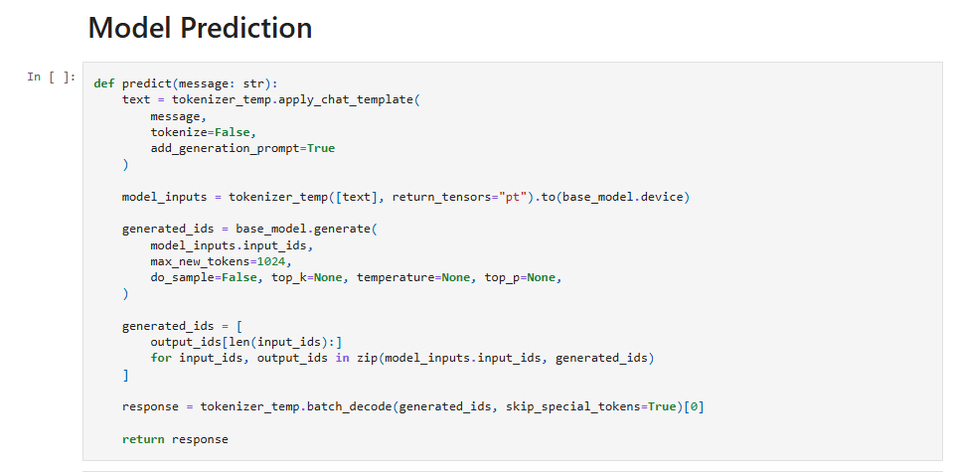
Code Snippet

Slide 12
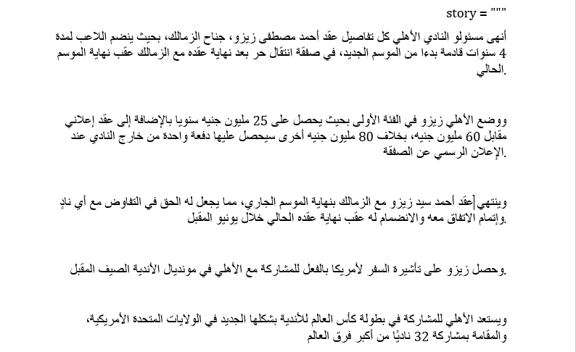
Input News Article

Slide 13
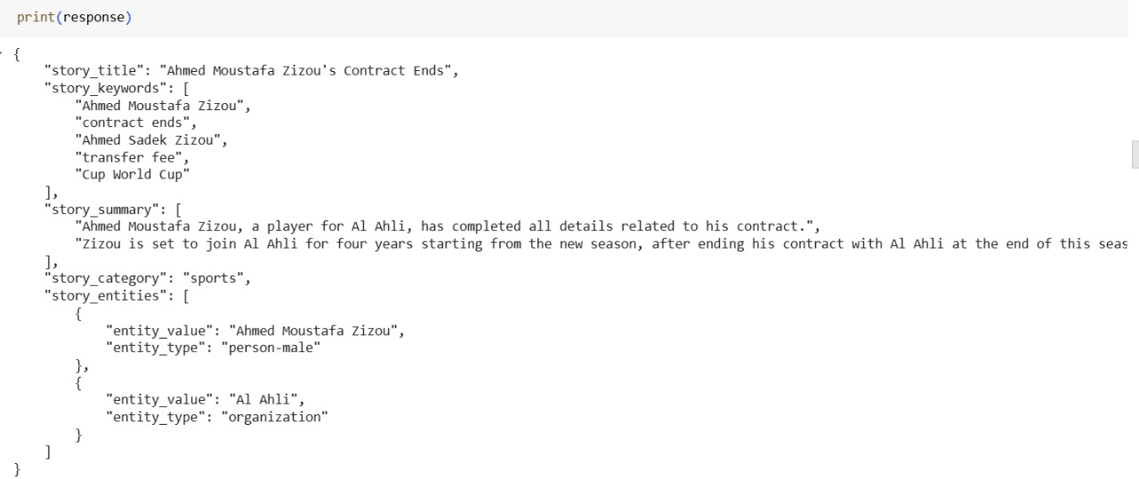
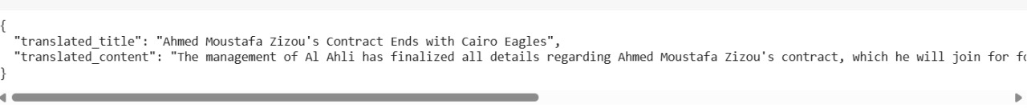
Problems Observed Before Fine-Tuning
❌ Language mismatch: The model was expected to generate the output in Arabic, but it responded in English.
❌ Incomplete Entity Extraction: Not all relevant entities were correctly identified or categorized.
❌ Partial Translation: The translated output was short and incomplete, missing key details from the original text.

Slide 14
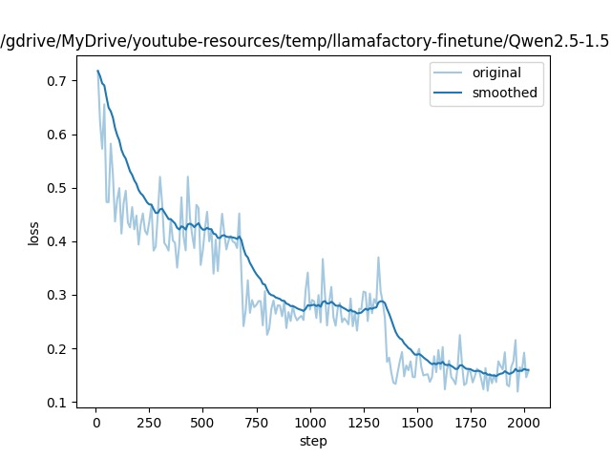
Fine-Tuning Progress – Loss Curve
This graph shows how the training loss (and optionally validation loss) decreased over time.
The downward trend indicates that the model is learning effectively from the training data.
Loss reduction confirms the success of the fine-tuning process.
📌 Lower loss = Better model performance

Slide 15
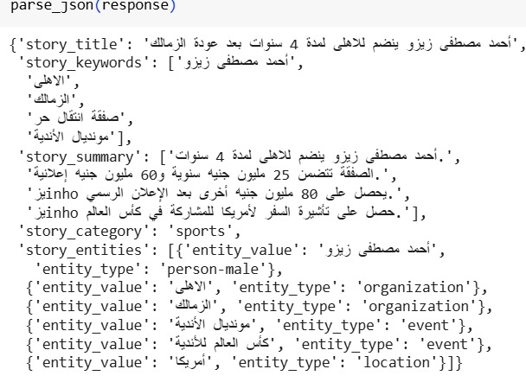
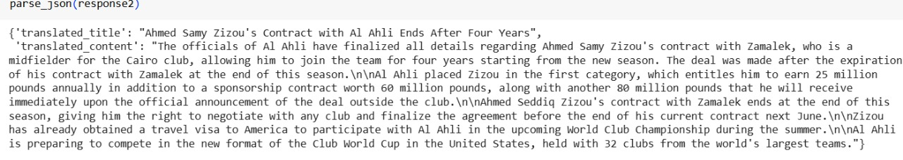
Running of The model After Fine-Tuning

Slide 16
Where You Can Try It!
GitHub: All project code and training scripts 🔗 https://github.com/YosefSamy019/DEPI_graduation_project
Streamlit App: Try the chatbot live 🔗 https://nadaeldarderi-depi-gradua-simple-chatbot-codelstm-app-v2-yhfzfy.streamlit.app/

Slide 17
Thank you !

